Slide 1
Car Price Prediction with Linear Regression Model
"Unlocking Market Insights for Geely Auto's US Entry

Slide 2
Introduction
A Chinese automobile company Geely Auto aspires to enter the US market by setting up their manufacturing unit there and producing cars locally to give competition to their US and European counterparts.
The company wants to know:
Which variables are significant in predicting the price
How well those variables describe the price of a car

Slide 4
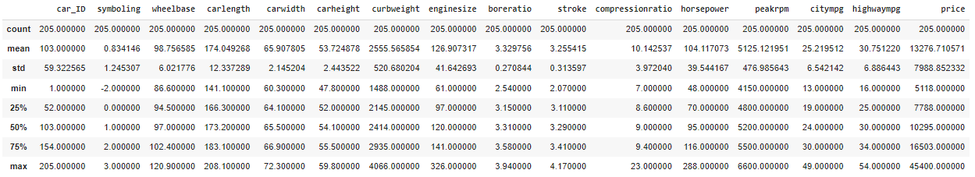
Step 1
Reading and Understanding the Data
Actions:
Importing essential libraries
Exploring dataset using head(), shape, describe(), info()

Slide 5
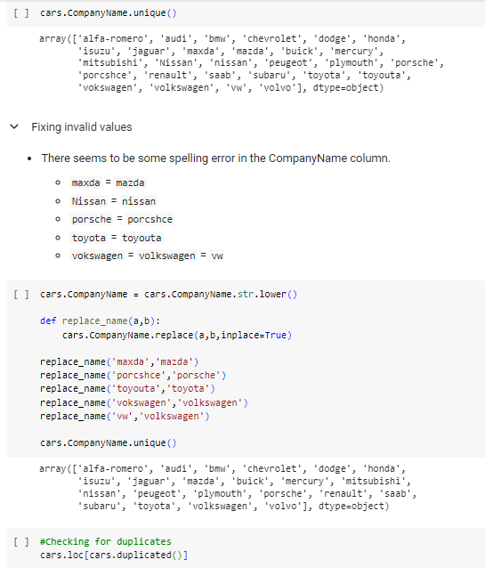
Step 2
Data Cleaning and Preparation
Tasks:
Splitting company name
Rectifying 'CompanyName' column
Checking for duplicates

Slide 6
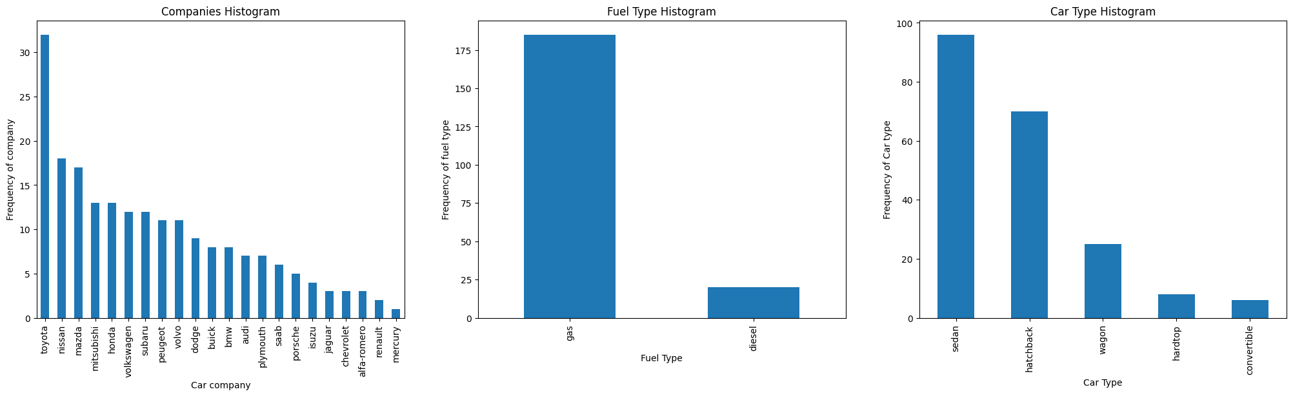
Step 3
Visualizing the Data
Visualizations:
Car price distribution plots, histograms

Slide 7
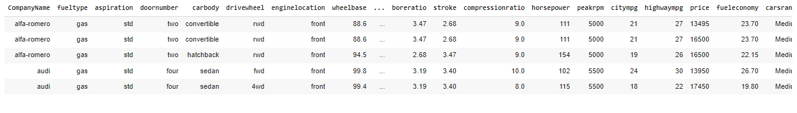
Step 4
Deriving New Features
Enhancements:
Creation of 'fueleconomy' variable
Categorization of car companies based on average prices

Slide 8
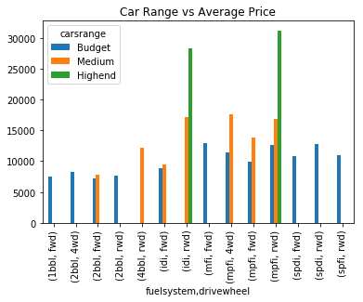
Step 5
Bivariate Analysis
Exploration:
Relationships between variables

Slide 9
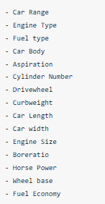
Step 6
List of Significant Variables

Slide 10
Model Building
Train-Test Split and Feature Scaling
Preparation:
Dataset division into training and testing sets
Feature scaling for uniformity in scale
Construction:
Linear regression model with selected variables for price prediction

Slide 11
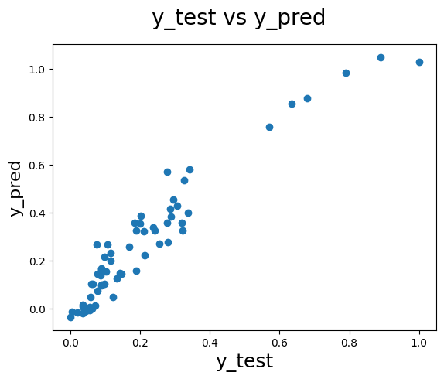
Prediction and Evaluation
Model used for predictions on the test dataset
R-squared score, scatter plot comparison
Model Accuracy
R-squared score: 0.7246

Slide 12
Thank You

